Slide 1
Introduction to Programming in Python
Conditional Statements
Yared Y.
yared@icraftsoft.com

Slide 2
if---else statement
while statement
for statement
break and continue

Slide 3
Control Statements
Python provides 3 selection statements that execute code based on a condition that evaluates to either True or False: The if statement performs an action if a condition is True or skips the action if the condition is False.
The if…else statement performs an action if a condition is True or performs a different action if the condition is False.
The if…elif…else statement performs one of many different actions, depending on the truth or falsity of several conditions.

Slide 4
Iteration Statements
Python provides two iteration statements—while and for: The while statement repeats an action (or a group of actions) as long as a condition remains True.
The for statement repeats an action (or a group of actions) for every item in a sequence of items.

Slide 5

if Statement
>>> grade = 90
>>> if grade >= 50:
print(‘passed!’)
output: passed! The condition grade >= 50 is True, so the indented print statement in the if’s suite displays 'Passed!’. NB. Indentation Matters. And the colon (:) is important. Don’t confuse ==(equality operator) with =(assignment operator)

Slide 6
Voting.py
age = 19
if age >= 18:
print(“You’re old enough to vote”)
age = 19
if age >= 18:
print(“You’re old enough to vote”)
else:
print(“Sorry, you’re too young.”)

Slide 7
if…else and if…elif…else statements
grade1.py
grade = 40
if grade >= 50:
print(‘Passed!’)
else:
print(‘Failed!’)
print(‘Take course again’)
output: Failed! Take course again
grade2.py
grade = 40
if grade >= 50:
result = ‘Passed!’
else:
result = ‘Failed!’
print(result)
output: Failed!

Slide 8
if…else with user input
rollercoaster.py
height = input(‘How tall are you in inches?’)
if int(height) >= 36:
print(“You’re tall enough to ride!”)
else:
print(“You’ll be able to ride when you’re a little older”)

Slide 9
Check if a number is odd or even Use Modulo Operator
even_or_odd.py
num = input(“Enter a number: ”)
if int(num) % 2 == 0:
print(str(num) + “ is even number”)
else:
print(“It’s odd number”)
Notes:
When one number is divisible by another number, the remainder is 0, so the modulo operator always returns 0.
You can use this fact to determine if a number is even or odd.

Slide 10
if…elif…else example
grade = 77
if grade >= 90:
print(‘A’)
elif grade >= 80:
print(‘B’)
elif grade >= 70:
print(‘C’)
elif grade >= 60:
print(‘D’)
else:
print(‘F’)
output: C
The first condition—grade >= 90—is False, so print('A') is skipped. The second condition—grade >= 80—also is False, so print('B') is skipped.
The third condition—grade >= 70—is True, so print('C') executes.
Then all the remaining code in the
if…elif…else statement is skipped. An if…elif…else is faster than separate if statements, because condition testing stops as soon as a condition is True.

Slide 11
Indentation Matters!
x = 10
if x % 2 == 0:
print(x, ‘ is even’)
if x % 5 == 0:
print(x, ‘ is divisible by 5’)
print(‘Output only when x is divisible by both 2 & 5’)
else:
print(x, ‘is not divisible by 5’)
print(‘Output only when x is divisible by 2, not by 5’)
else:
print(x, ‘is odd’)
print(‘No Indentation. Output in all cases’)
Notes:
What is indentation? amount of whitespace or tab characters in front of your code.
important in Python because it groups blocks of code together

Slide 12
Challenge 1: friendship_park.py
Say Freindship park in Addis charges different rates for different age groups Admission for anyone under age 10 is free. Admission for anyone between the ages 10 and 18 is 100 Birr Admission for anyone age 18 or older is 300 Birr How can we use an if statement to determine a person’s admission rate? Use user input from keyboard along with an if-elif-else statement.

Slide 13
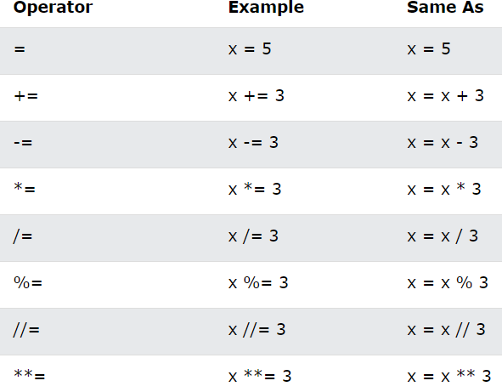
Python Assignment Operators (Revisited)
>>> x = 5
>>> x = x + 1
>>> print(x)
output: 6
>>> x = 5
>>> x += 1 //x = x + 1
>>> print(x)
output: 6
Notes:
Updating Variables: x= x + 1 this means “get the current value of x, add one, and then update x with the new value.”

Slide 14
while statement
A while loop statement repeatedly executes a target statement as long as a given condition is true Syntax while expression:
statement(s)
Here, statement(s) may be a single statement or a block of statements. The condition may be any expression, and true is any non-zero value. The loop iterates while the condition is true.
When the condition becomes false, program control passes to the line immediately following the loop

Slide 15
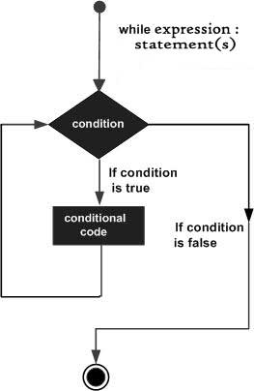
while loop flow diagram
i = 1
while i <= 4:
print(i)
i = i + 1
print(“Done”) When the above code is executed, it produces: 1
2
3
4 Done

Slide 16
while statement
The while statement allows you to repeat one or more actions while a condition remains True. Example:
i = 1
while i <= 5:
print(i)
i = i + 1
print(“Done”)
power_of_three.py
// find the first power of 3 larger than 50
num = 3
while num <= 50:
num = num * 3
print(num)
Output: 9 27 81

Slide 17
while loop control flow
while <condition>:
<expression>
<expression>
...
<condition> evaluates to a Boolean if <condition> is True, do all the steps inside the while code block.
Check <condition> again
Repeat until <condition> is False.

Slide 18
Membership Operators (Revisited)
Python's in operator lets you loop through all the members of a collection(such as a list or a tuple) and check if there's a member in the list that's equal to the given item. >>> list = (1,2,3)
>>> 3 in list Output: True
>>> 35 not in list Output: True

Slide 19
Python range() function
The range() function returns a sequence of numbers, starting from 0 by default, and increments by 1 (by default), and stops before a specified number. Syntax: range(start, stop, step)
Example: print numbers from 3 to 5 nums = range(3,6)
for n in nums:
print(n)
Notes:
Start Optional. An integer number specifying at which position to start. Default is 0
Stop Required. An integer number specifying at which position to stop (not included).
Step Optional. An integer number specifying the incrementation. Default is 1

Slide 20
for loop
for loops are used when you have a block of code which you want to repeat a fixed number of times.
The for-loop is always used in combination with an iterable object, like a list or a range.
For loop from 0 to 2, therefore running 3 times.
for n in range(0,3):
print(n)
n = 0
while n < 3:
print(n)
n = n + 1

Slide 21
for loop
for n in range(1,10,3): //printing with step
print(n)
for n in range(3): //same as range(0,3)
print(n)
for n in range(30,3,-2): //using negative range
print(n)
for statement repeats an action (or a group of actions) for every item in a sequence of items
while statement repeats an action (or a group of actions) as long as a condition remains True

Slide 22
Sum of numbers from 1 to 10
Using while loop
n = 1
sum = 0
while n <= 10:
sum = sum + n
n = n + 1
print(sum)
// sum += n
Output: 55
Using while for
sum = 0
for n in range(1,11):
sum += n
print(sum)
Output: 55

Slide 23
Challenge class_average.py
Consider the following requirements statement:
A class of ten students took a quiz. Their grades (integers in the range 0 – 100) are
98, 76, 71, 87, 83, 90, 57, 79, 82, 94.
Determine the class average on the quiz.

Slide 24
class_average.py
sum = 0 // sum of grades
counter = 0 // grade counter
grades = (98, 76, 71, 87, 83, 90, 57, 79, 82, 94)
for grade in grades:
sum = sum + grade
counter += 1
print(“Average is: “, sum/counter)

Slide 25
break
Executing a break statement in a while or for immediately exits that statement.
In the following code, range produces the integer sequence 0–99, but the loop terminates when number is 10: for n in range(100):
if n == 10:
break
print(n)
The break statement terminates the loop containing it.
Control of the program flows to the statement immediately after the body of the loop

Slide 26
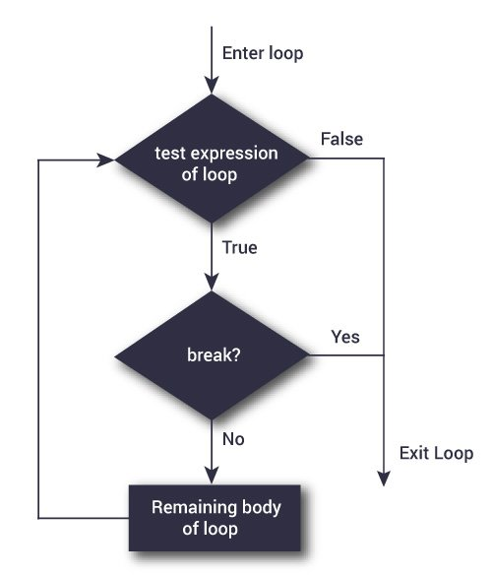
Flow chart of break statement
n = 10 while n > 0:
if n == 4:
break
print(n)
n -= 1
Output: 10,9,8,7,6,5
//Alternative
print(n)
n -= 1
If n ==4:
break

Slide 27
continue
Executing a continue statement in a while or for loop skips the remainder of the loop’s suite.
In a while, the condition is then tested to determine whether the loop should continue executing.
In a for, the loop processes the next item in the sequence (if any) for n in range(10):
if n == 4:
continue
print(n) 0 1 2 3 5 6 7 8 9
n = -1 while n <= 10:
n += 1
if n == 4:
continue
print(n) 0 1 2 3 5 6 7 8 9
Notes:
The continue statement is used to skip the rest of the code inside a loop for the current iteration only.
Loop does not terminate but continues on with the next iteration.

Slide 28
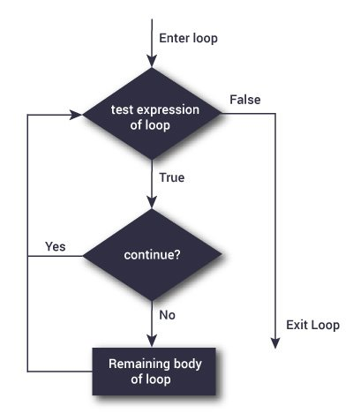
Flow chart of continue statement
n = 10 while n > 0:
n -= 1
if n == 4:
continue
print(n)
Output: 10,9,8,7,6,5,3,2,1

Slide 30
https://python.land/introduction-to-python
https://www.learnpython.org/en/Variables_and_Types
https://www.w3schools.com/python/default.asp

